Slide 1
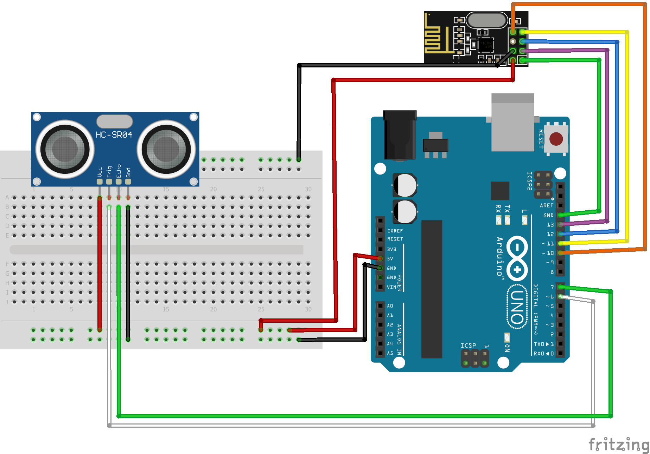
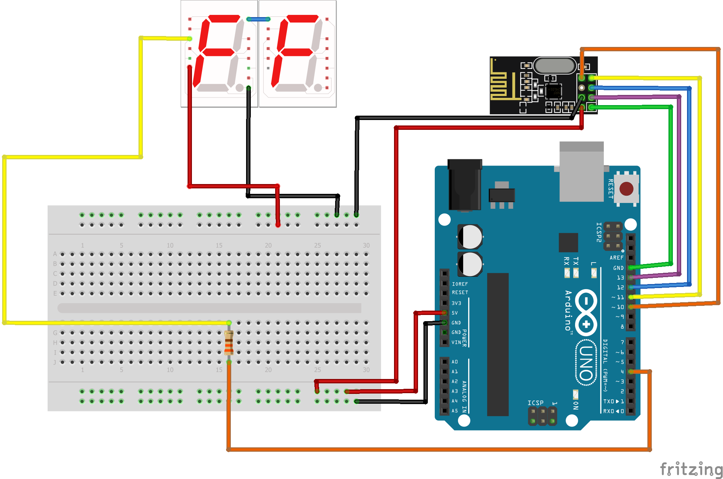
Circuit Diagrams of Sensor and Display Unit
(made with Fritzing)
Transmitting Circuit Receiving Circuit

